Slide 1
Changes in Market Conditions
Rajiv Sethi and the CORE Team

Slide 2
Overview
Shifts in demand and supply curves
Effects on prices of excess demand and supply
Adjustment of quantities
Effects of a sales tax
Reading: The Economy Units 8.6 to 8.7

Slide 3
Observables
Demand and supply curves are not observable
What we observe is price and quantity
But we can often deduce that shifts have occurred, and identify reasons
Shift in curve means change in demand/supply at every price
Demand shifts: changes in preferences, demographic characteristics
Supply shifts: changes in technology, input prices
Taxes create a wedge between price paid and received
With care, can be viewed as supply shift

Slide 4
Demand Shifts

Slide 5
Demand Shift
Suppose a market for books is initially at equilibrium
Consider upward shift in demand
Could be due to higher enrollment for example
Greater demand at every price, so entire curve shifts
At initial price we have excess demand
This causes price to be bid up as buyers compete for goods
Until equilibrium is restored at higher price and quantity
What if demand had gone down?

Slide 6
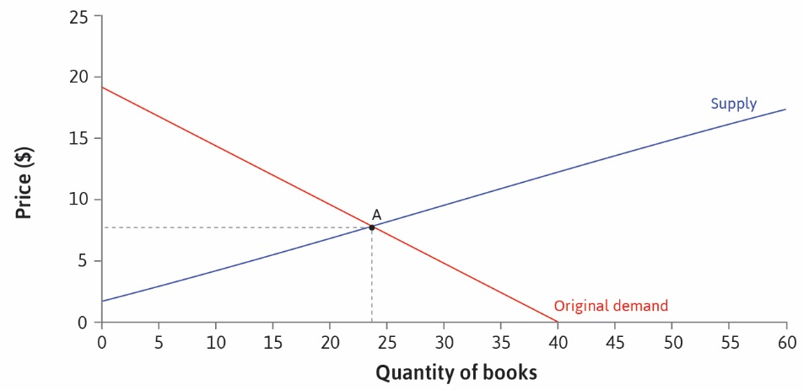

Slide 7
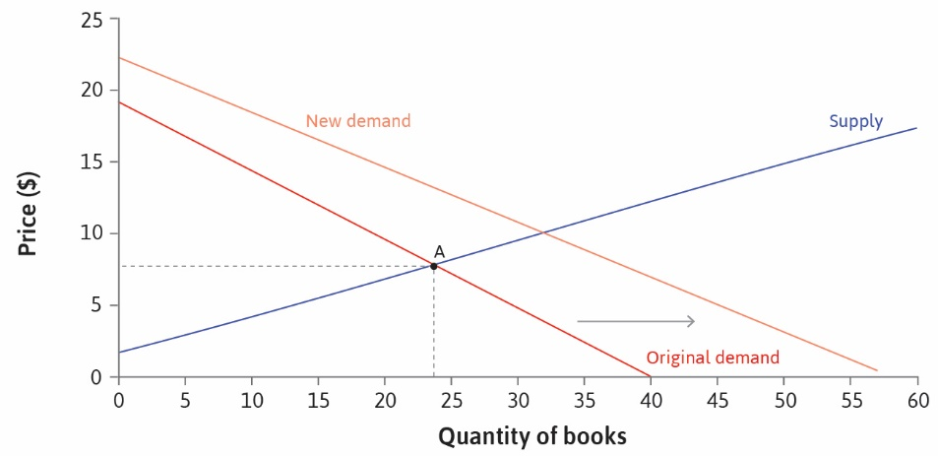

Slide 8
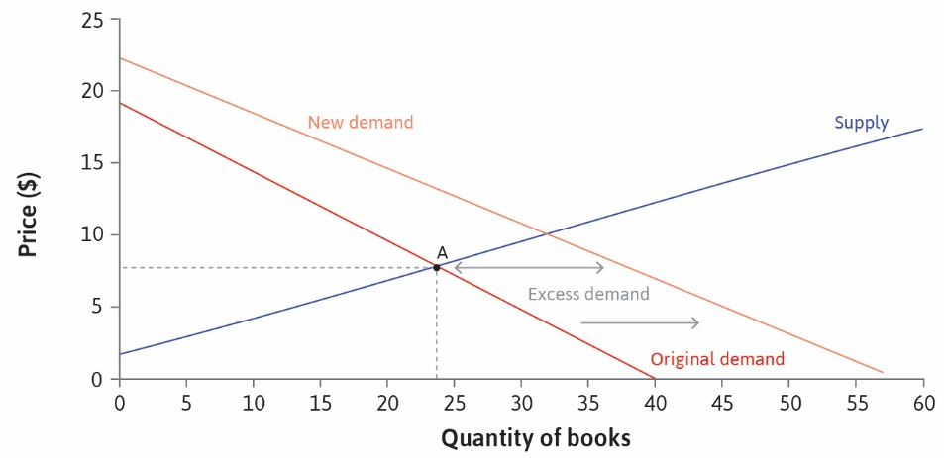

Slide 9
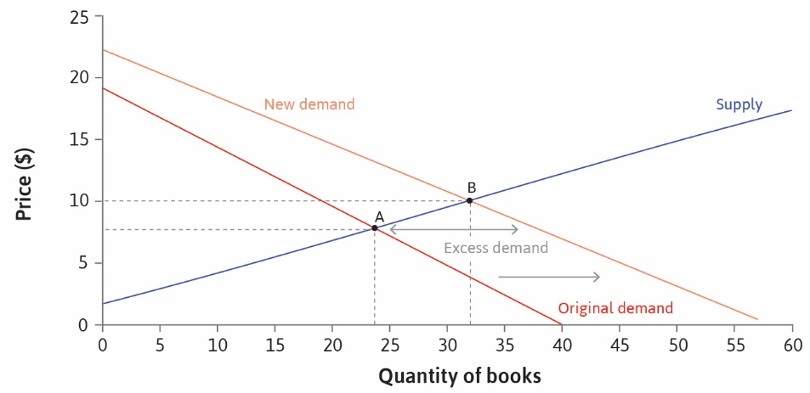

Slide 10
Preferences
Changes in preferences can also induce a demand shift
Example: large changes in demand for quinoa
Results in higher price and (eventually) higher quantity
Note: we only observe higher price and quantity
Can infer shift in demand

Slide 11
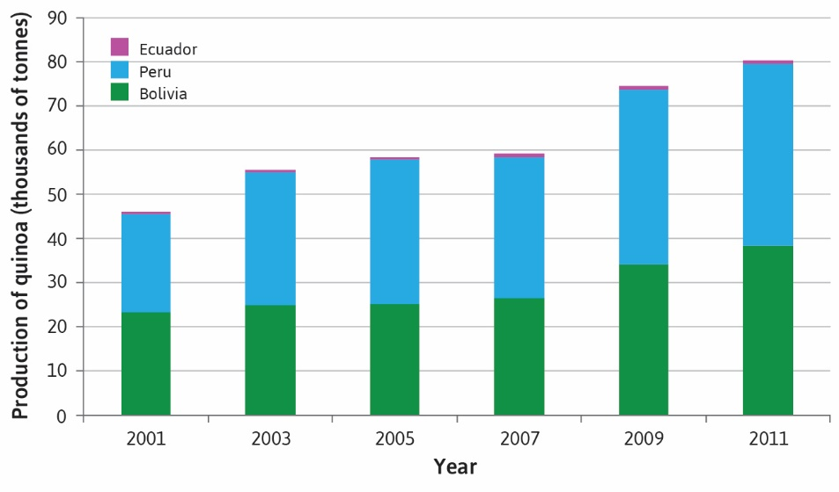

Slide 12
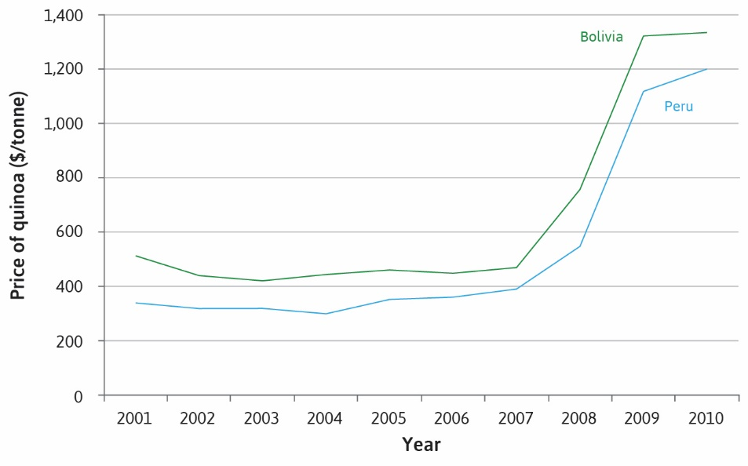

Slide 13
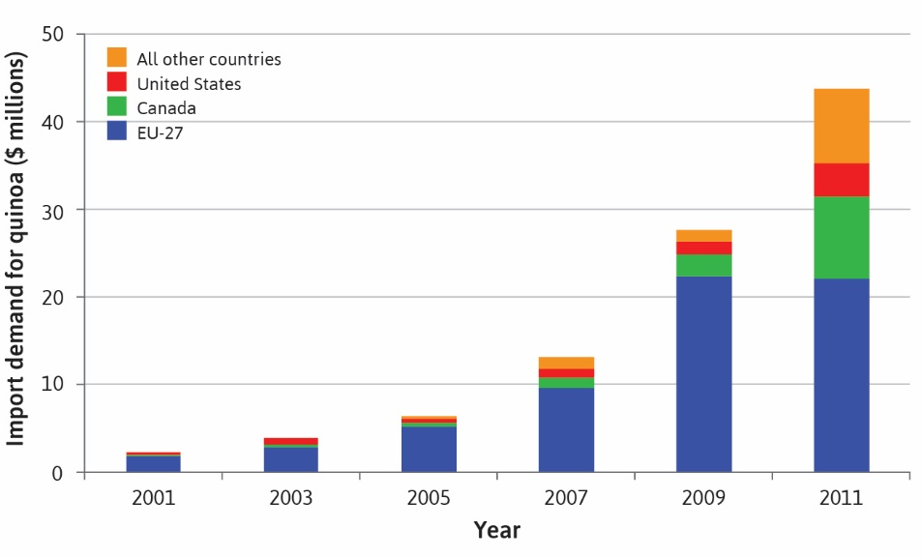

Slide 14
Supply Shift
Suppose a market for bread is initially at equilibrium
Consider outward shift in supply
Could be due to lower costs of production or lower price of grain
Greater supply at every price, so entire curve shifts
At initial price we have excess supply
This causes price to be bid down as sellers compete for customers
Until equilibrium is restored at lower price and higher quantity
What if supply had gone down (shifted left)?

Slide 15
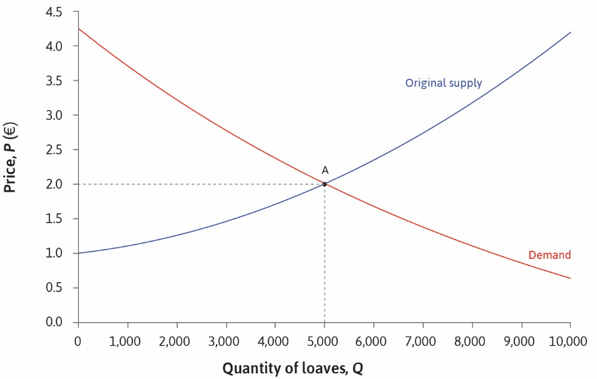

Slide 16
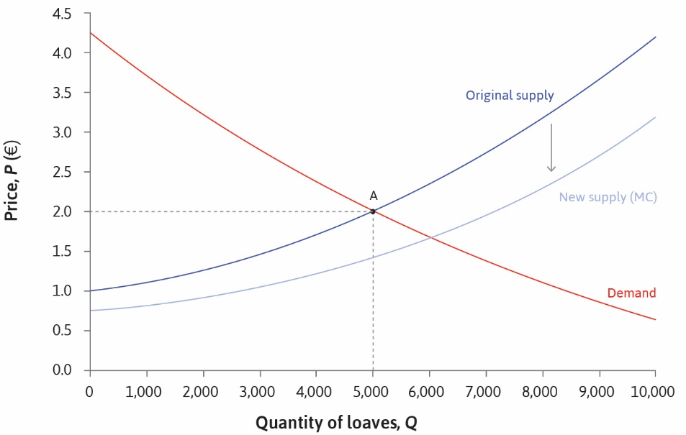

Slide 17


Slide 18
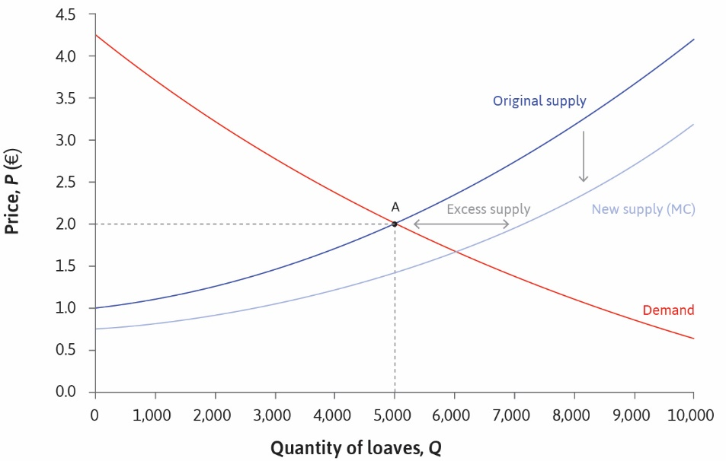

Slide 19
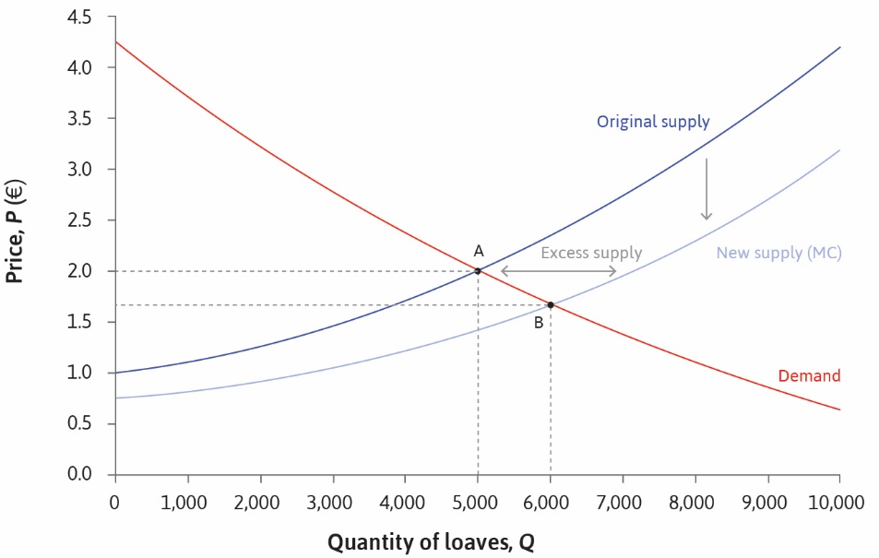

Slide 20
Taxes
Sales taxes create wedge between what buyers pay and sellers receive
Suppose vertical axis plots what buyers pay (after-tax price)
Then demand curve is unaffected
What about supply curve?
At any given after-tax price, supply will be based on pre-tax price
Example: 30% tax on sales
So if pre-tax price is $1.00, after tax price is $1.30
Supply at price $1.30 is what it would have been at price $1.00 without tax
Which is like a shift left of the supply curve

Slide 21
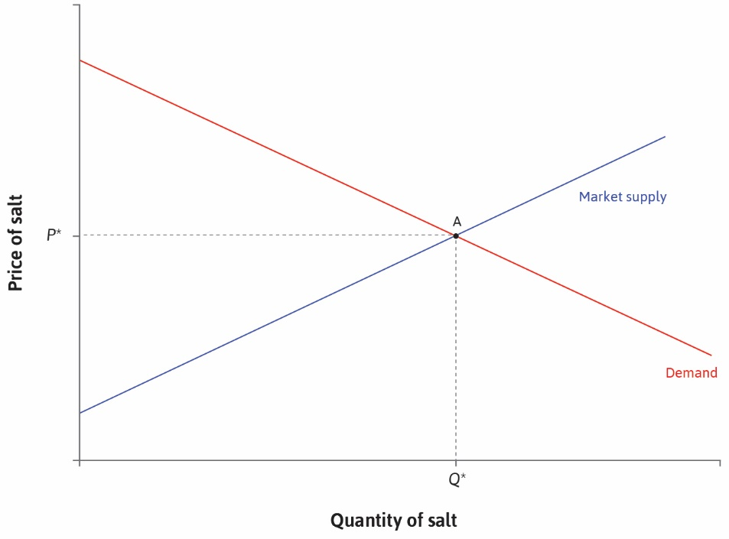

Slide 22
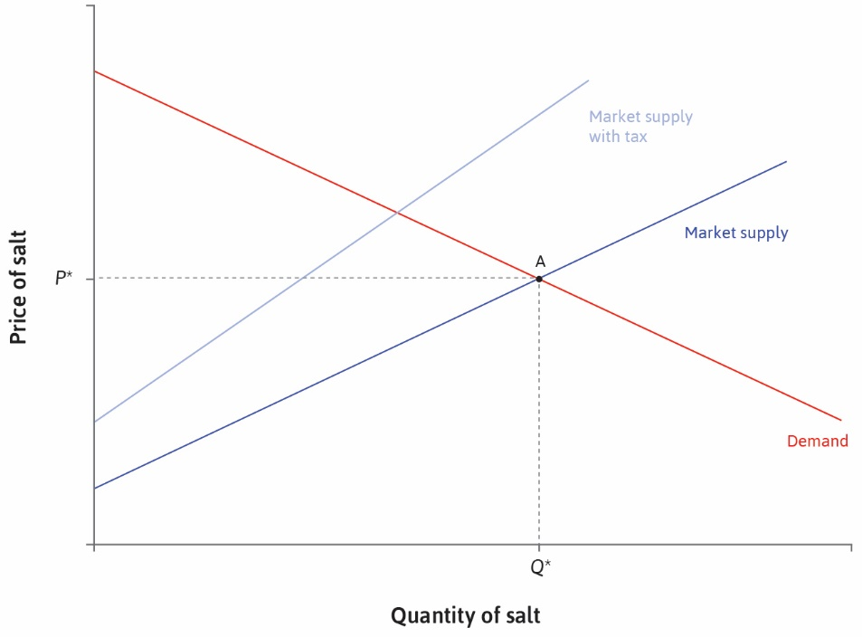

Slide 23
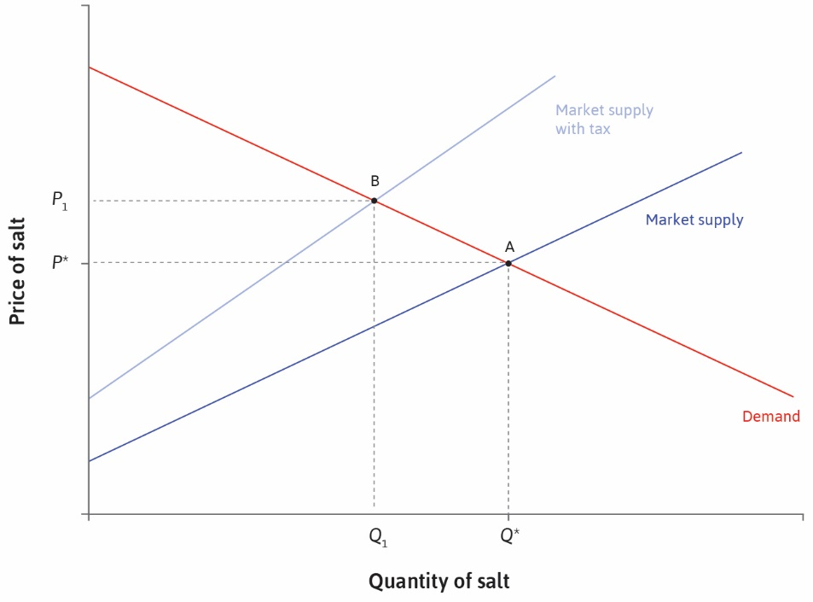

Slide 24
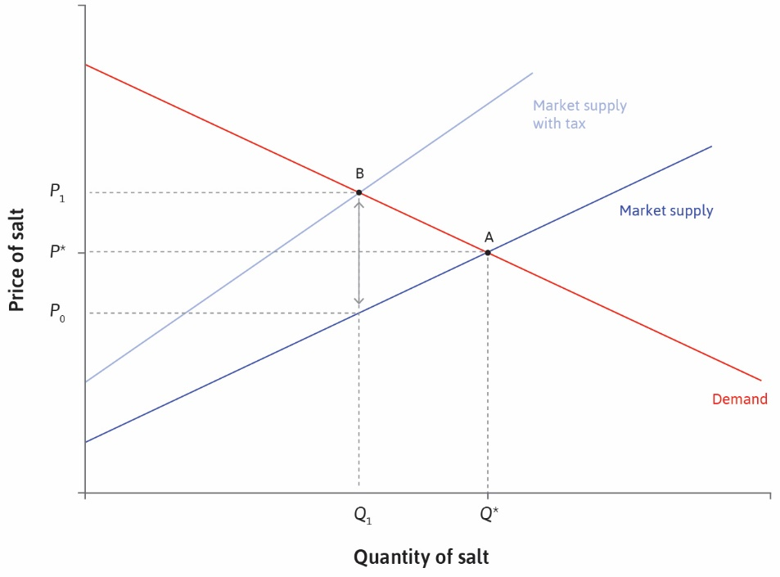

Slide 25
Deadweight Loss
Quantity sold falls after imposition of tax
Consumer surplus falls since (after-tax) price is higher and fewer buy
Producer surplus fall since (pre-tax) price is lower and sales are lower
Deadweight loss emerges, but government raises revenue
Is this (Pareto) inefficient?
Depends on what revenues are used for
Also, reduction in quantity of some goods may yield social benefits

Slide 26
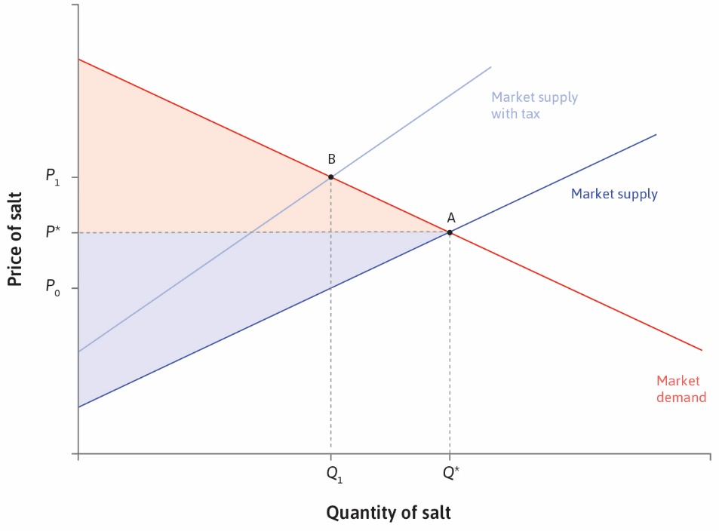

Slide 27
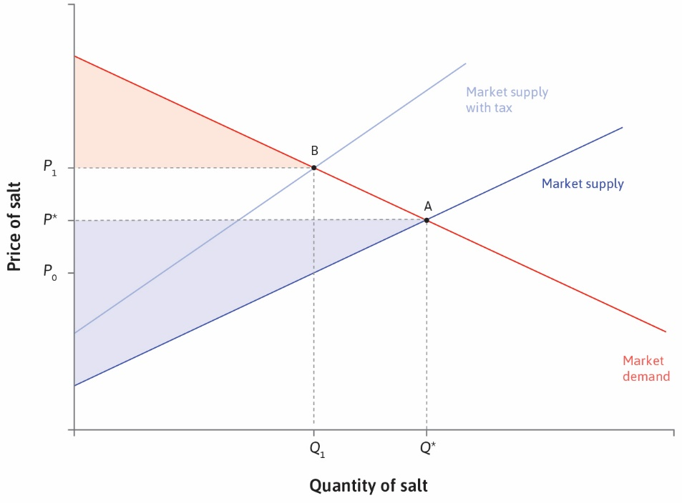

Slide 28
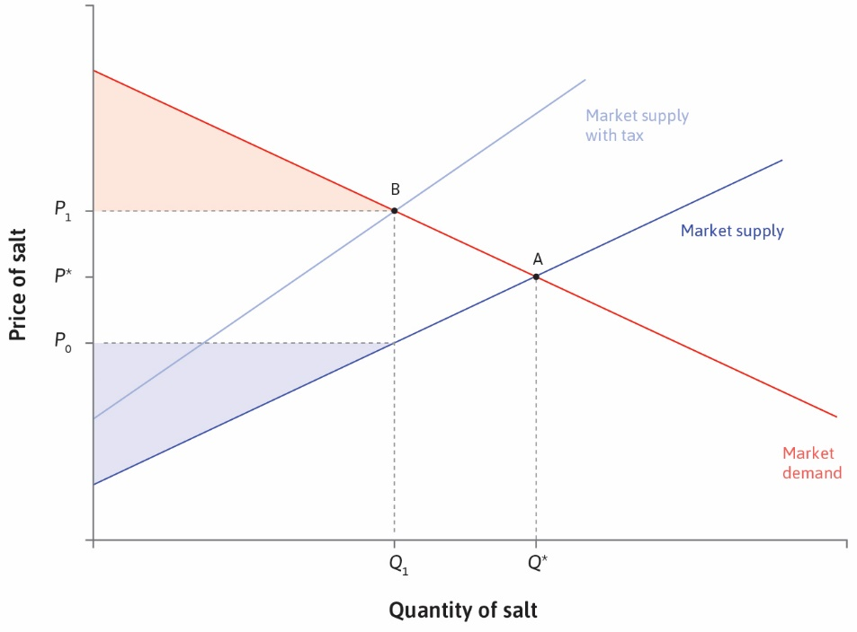

Slide 29
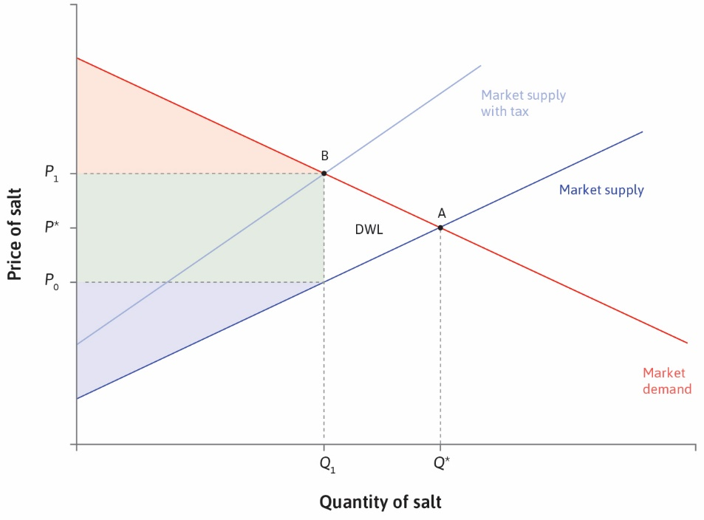

Slide 30
Tax Incidence
Who actually pays the tax?
Both buyer and seller pay
Buyer pays more but seller gets less
How is the burden distributed?
Depends on the slope of demand and supply functions
A flat supply curve means tax incidence falls mostly on buyer
In this case quantity falls a lot
What about steep supply? Flat demand? Steep demand?

Slide 31
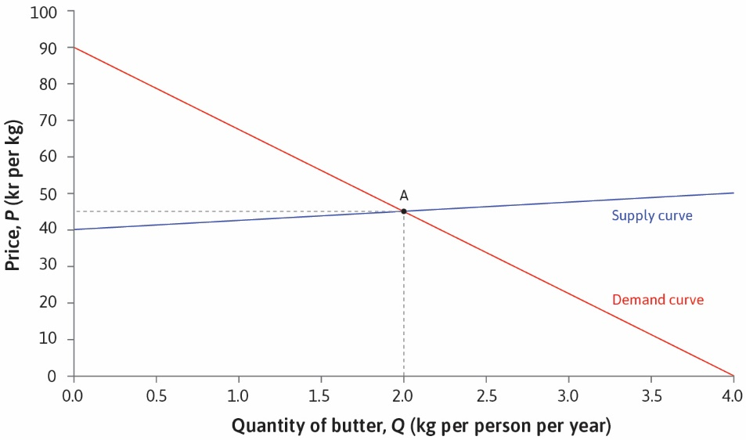

Slide 32
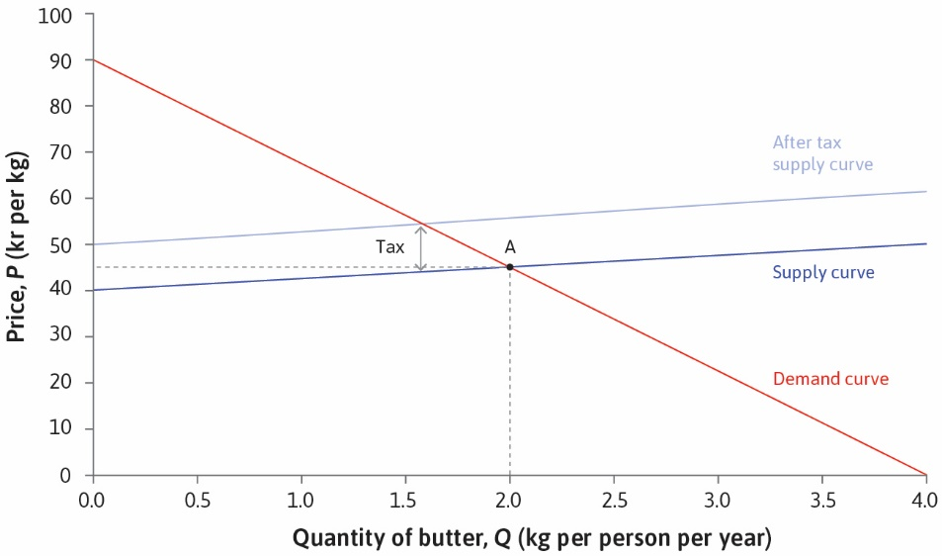

Slide 33
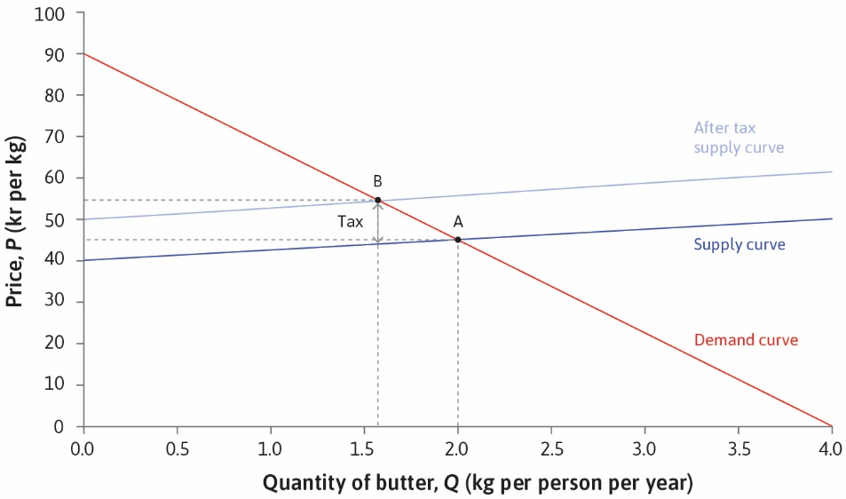

Slide 34
